Slide 1
数据结构扩展(一) Binary Lifting(倍增)
1483. Kth Ancestor of a Tree Node
你们的好朋友Eddie

Slide 2
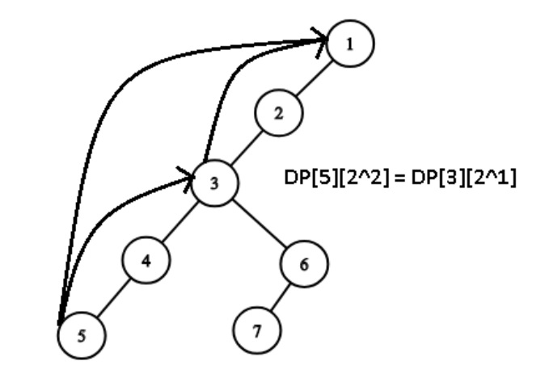
What is binary lifting?
int halfJumpParent = dp[i][j - 1]
dp[i][j] = dp[halfJumpParent][j - 1]
i is the current node
j is the (2 ^ j) th parent
Binary Lifting is a technique used to find the k-th ancestor of any node in a tree in O(logn). This also leads to a faster algorithm in finding the lowest common ancestor (LCA) between two nodes in a tree. It can also be used to compute functions such as minimum, maximum and sum between two nodes of a tree in logarithmic time. The technique requires preprocessing the tree in O(N log N) using dynamic programming.

Slide 3
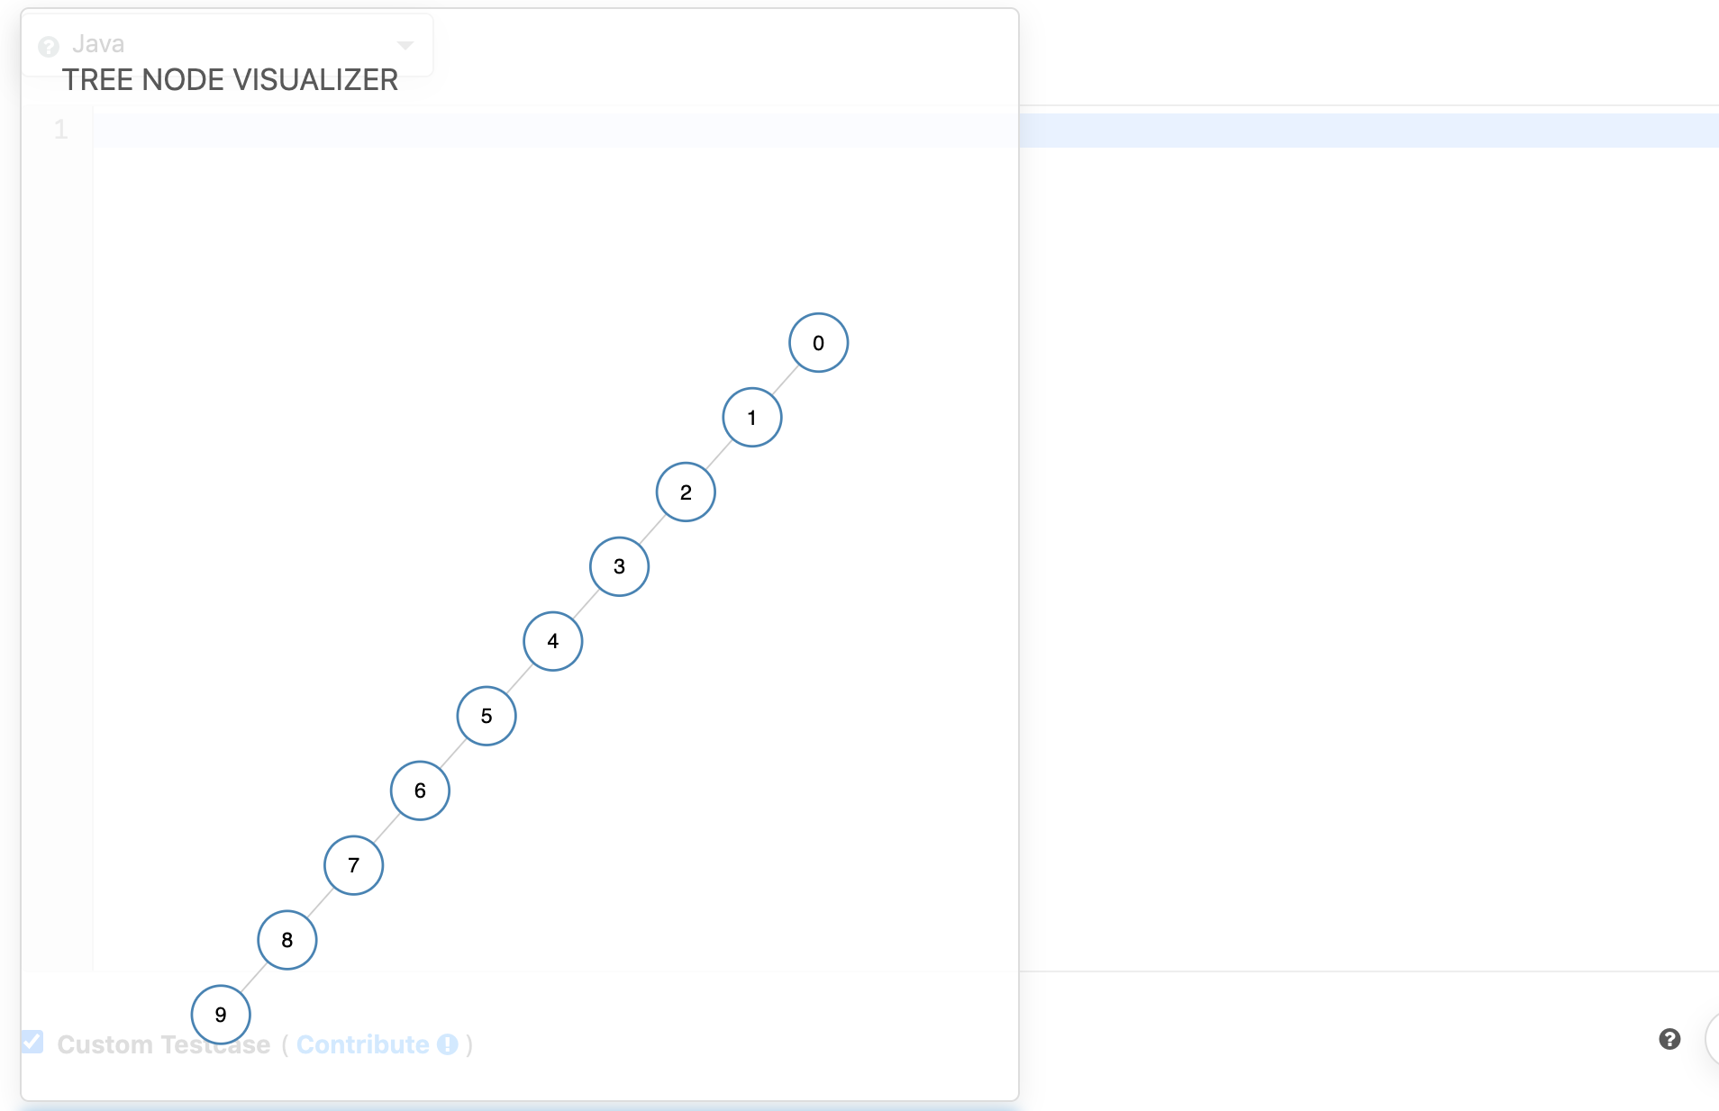
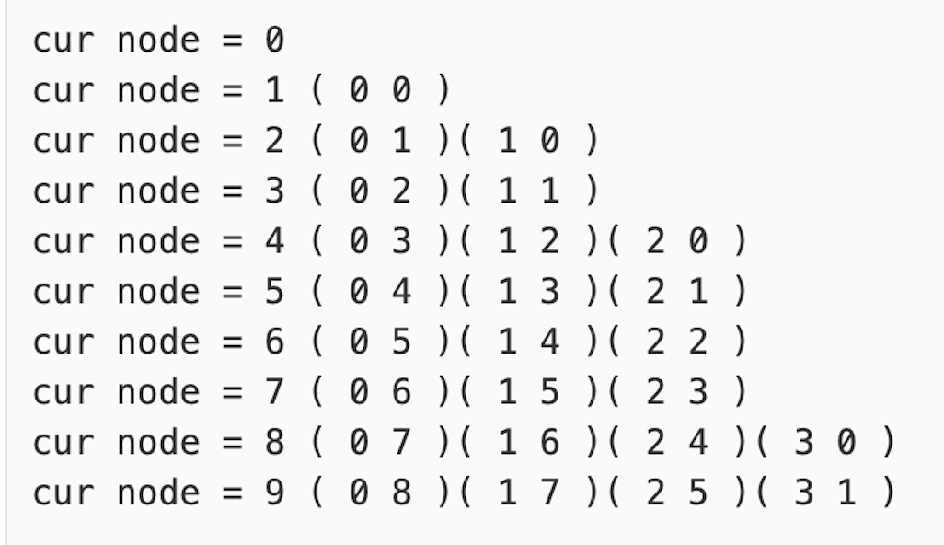
[a, b] 2^ath parent node is b

Slide 4
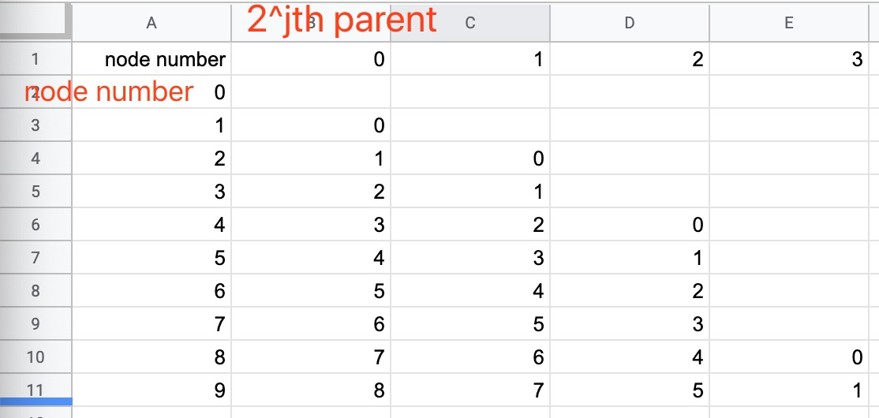

Slide 5
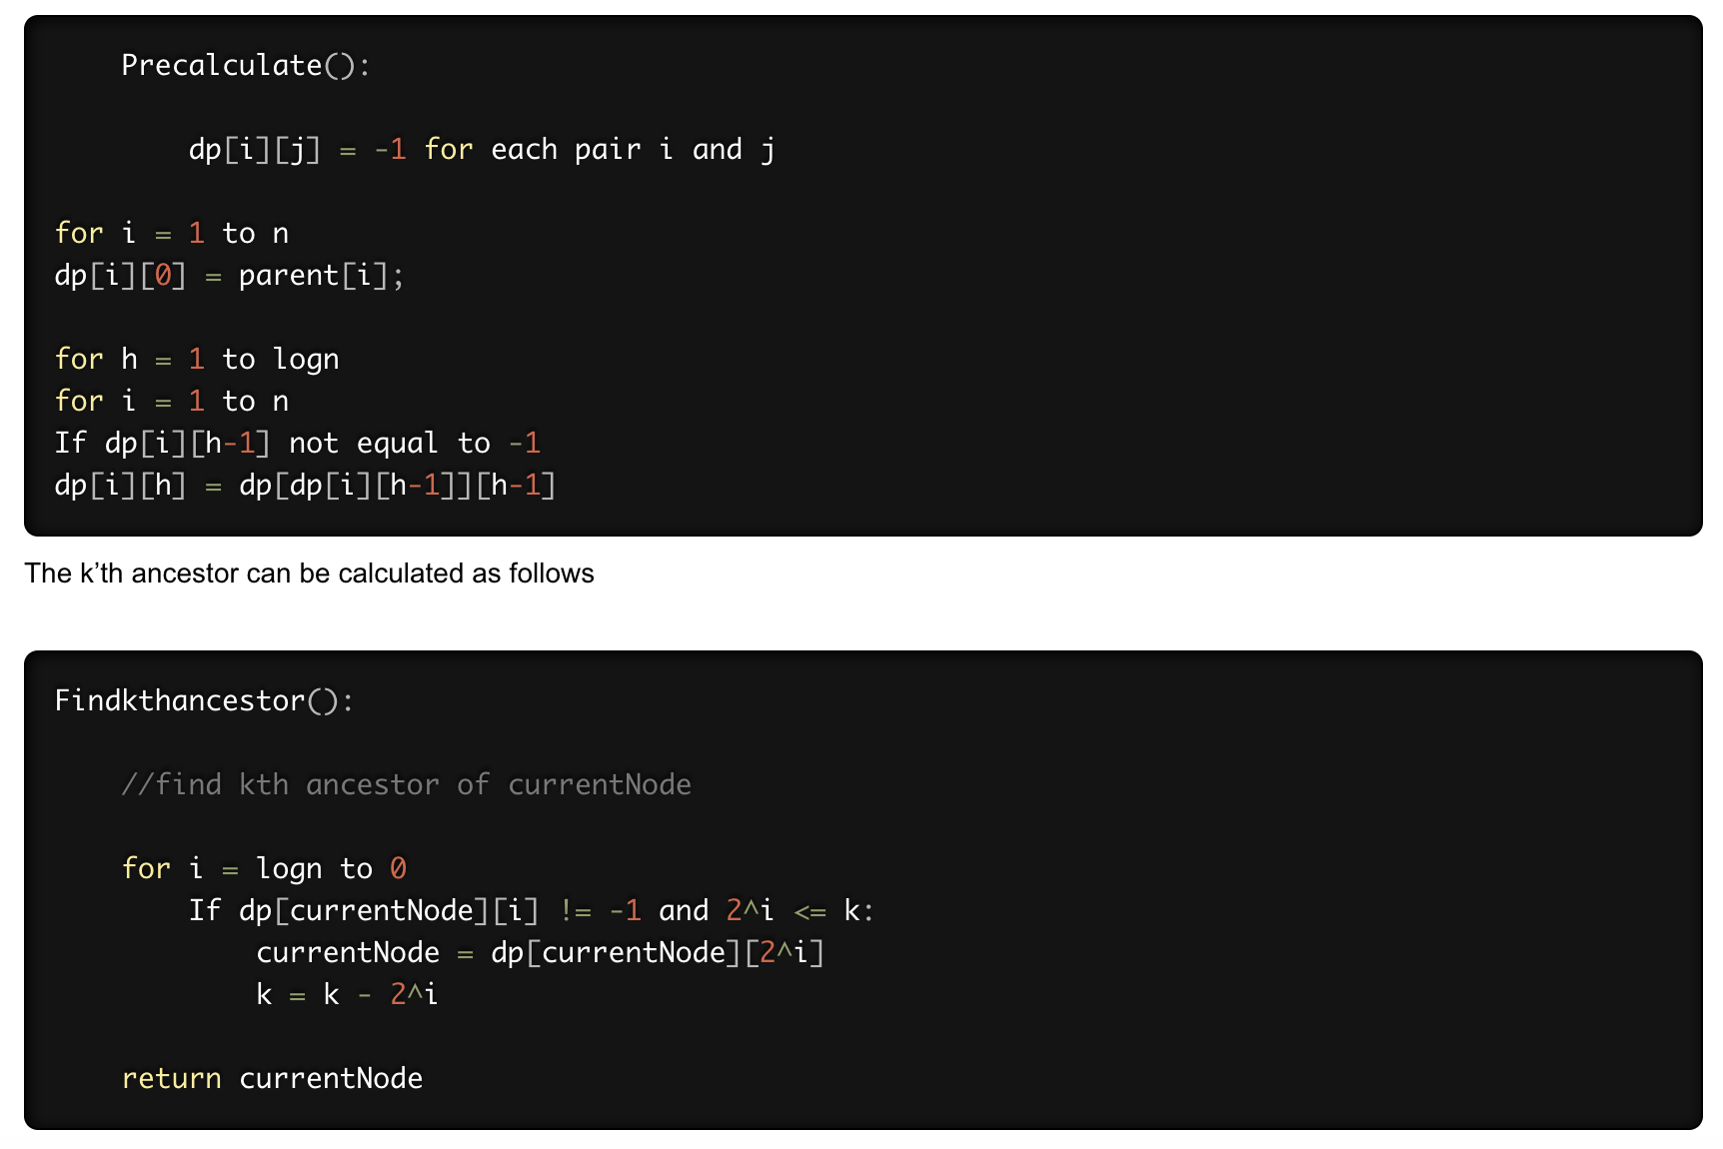

Slide 6
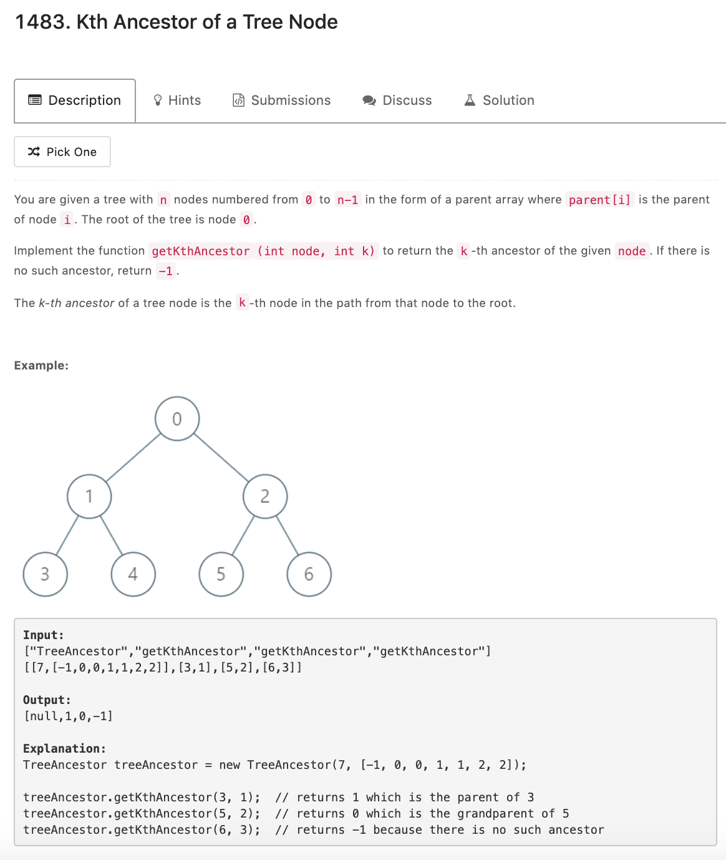
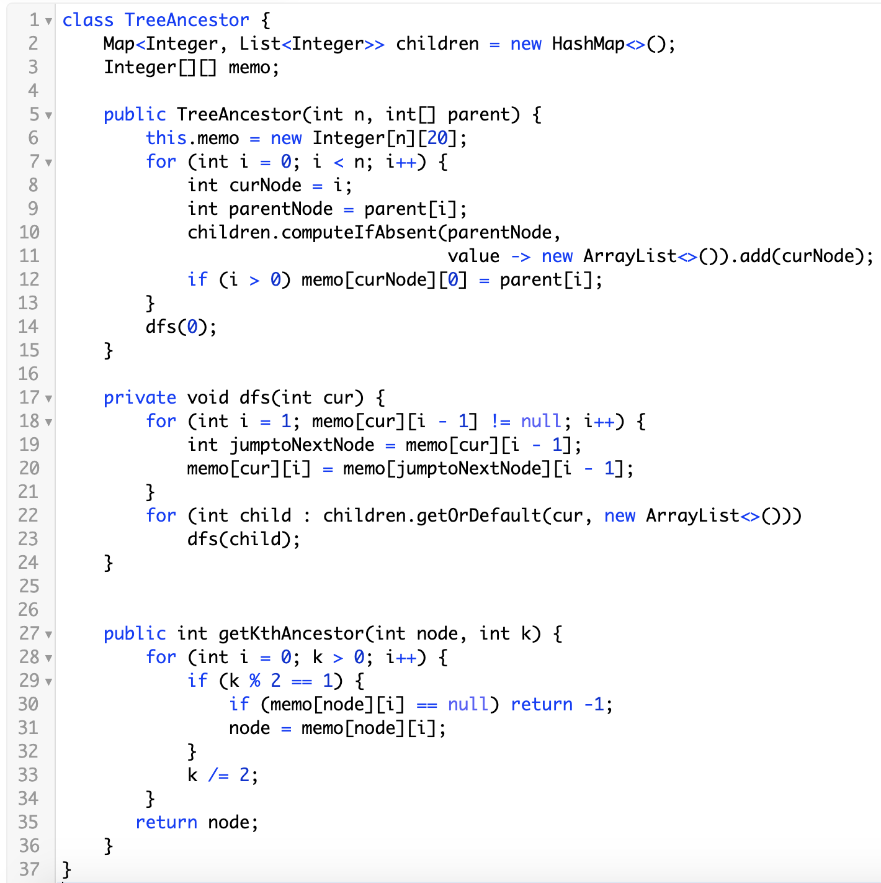
做logn次
对n个node做同样的事情

Slide 7
Summary
Time O(nlogn) preprocessing, O(logn) query
Space O(nlogn)
也可以用来处理LCA类问题，但是本身考察不太多，掌握普通dfs的基础上 good to know

